Slide 1
AWS COMMUNITY DAY DAVAO 2026 · HANDS-ON WORKSHOP
Build Your Own Context
A Personal MCP Server with S3, Lambda,
API Gateway and Cognito
PRESENTED BY
Arlou A. Beloria
OPEN THE ATTENDEE GUIDE
www.arloubeloria.com/workshop/vault-brain
Notes:
Opening slide. Ask attendees to open https://www.arloubeloria.com/workshop/vault-brain before moving to the Did You Know story. Presenter: Arlou A. Beloria. The workshop title is Build Your Own Context: A Personal MCP Server with S3, Lambda, API Gateway and Cognito.

Slide 2
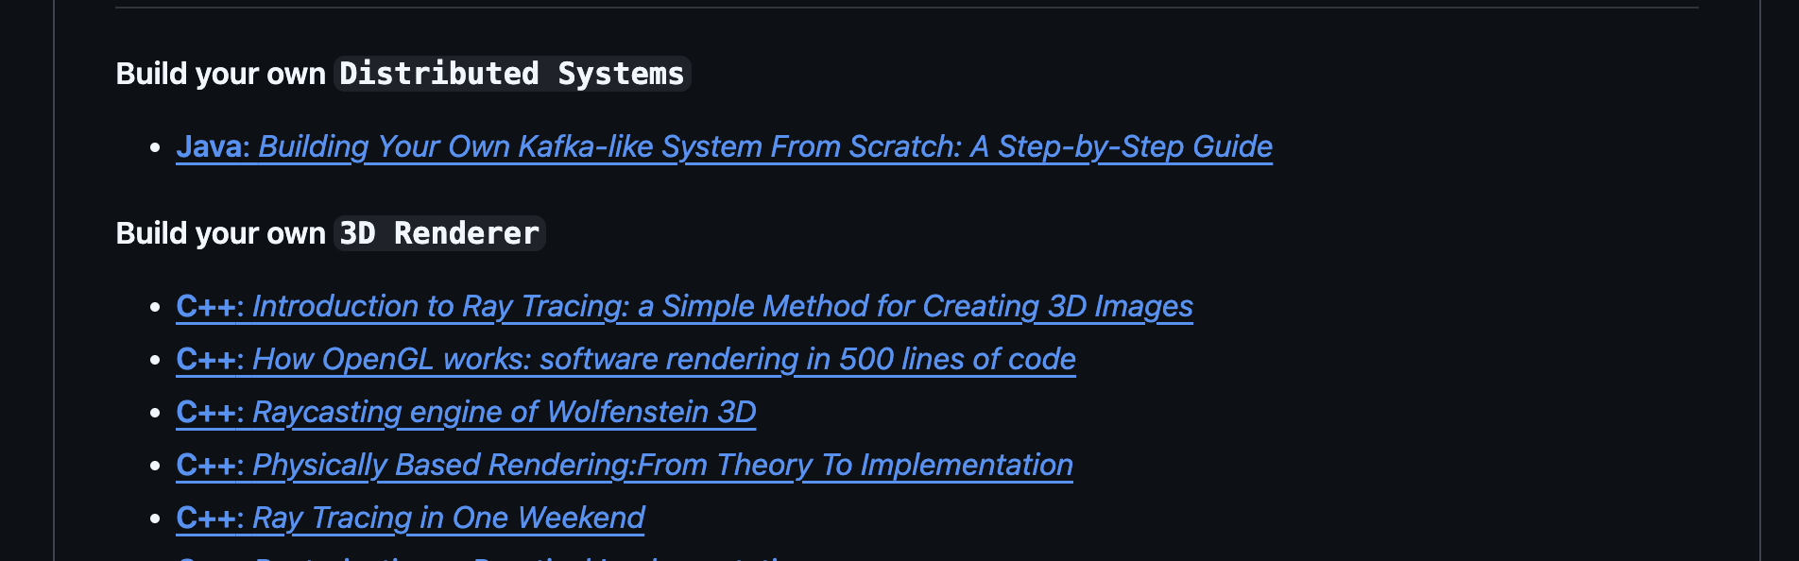
DID YOU KNOW?
A Markdown file can carry a world
Build Your Own X organizes practical knowledge in a Markdown file, not a complex application. Vault Brain follows the same idea for your context, with MCP as the access layer.
github.com/codecrafters-io/build-your-own-x
Notes:
The image is the attendee's real capture of the Build Your Own X README on September 26, 2026, cropped only to remove the browser tab bar. It shows the Tutorials section, including Distributed Systems and 3D Renderer links. The repository also has supporting files. Sources: https://github.com/codecrafters-io/build-your-own-x and https://raw.githubusercontent.com/codecrafters-io/build-your-own-x/master/README.md . The attendee guide begins at https://www.arloubeloria.com/field-notes

Slide 3
THE PROBLEM
The context tax
You explain your projects to one AI client. When you switch, the next client starts without that history.
Repeated explanation costs time.
Notes:
The instructor moved from Claude to OpenAI while keeping core context in Markdown. The same notes did not have to be rebuilt inside the new provider. Guide: https://www.arloubeloria.com/workshop/vault-brain#context-lock-in

Slide 4
What is a Vault Brain?
Your durable context lives as Markdown in your own S3 bucket.
MCP gives AI clients controlled access.
Obsidian lets you read and edit the same notes yourself.
Notes:
A Vault Brain in this workshop is a private Markdown vault in Amazon S3. The MCP server offers authenticated tools to AI clients. Obsidian synchronizes directly to the same S3 bucket for a human-readable view. Guide: https://www.arloubeloria.com/workshop/vault-brain#three-layers

Slide 5
Three layers, three jobs
03 AI CLIENTS
AI clients
Claude web, ChatGPT, future MCP clients
02 TOOLS + ACCESS
01
Tools and access
Core
context
Vault Brain MCP and Cognito
Core context
Readable Markdown in private Amazon S3
Obsidian syncs directly with the same S3 Markdown.
Notes:
Layer 1 is private, versioned Markdown in S3. Layer 2 is authenticated access through Vault Brain MCP. Layer 3 is the replaceable AI client. Obsidian syncs directly with the S3 Markdown bucket. Terraform state lives in a separate bucket. Guide: https://www.arloubeloria.com/workshop/vault-brain#three-layers

Slide 6
Switch clients, keep the context
01
Keep the vault in your AWS account
02
Connect another MCP-capable client
03
Continue from the same Markdown
I moved from Claude to OpenAI without rebuilding my notes.
Notes:
The instructor moved from Claude to OpenAI without rebuilding the Markdown context. Other MCP-compatible clients can use the same vault subject to each client's connection features and permissions. Guide: https://www.arloubeloria.com/workshop/vault-brain#benefits

Slide 7
THE ANALOGY
The MCP server is the librarian
The vault holds the books. The AI client asks the server to find, read, or file something.
MCP is the common language for that request.
Notes:
MCP gives AI applications a standard way to discover and use external tools. Official architecture: https://modelcontextprotocol.io/docs/2026-07-28/learn/architecture . Guide: https://www.arloubeloria.com/workshop/vault-brain#mcp-in-plain-english

Slide 8
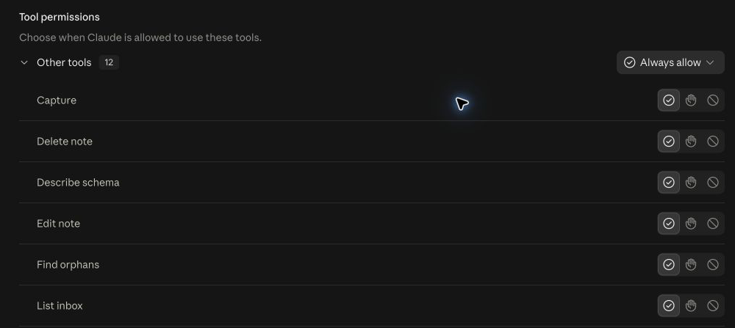
The client discovers tools
tools/list
ONE TOOL CONTRACT
search_vault
The server describes the tools it offers.
description
Find text inside notes
input schema (simplified)
{ query: string }
The client supplies this contract alongside your message.
REAL CLAUDE WEB CAPTURE · 12 CONNECTED TOOLS
Tool contracts contain no AWS keys or handler code.
Review write and delete permissions before use.
Notes:
This is a genuine Claude web capture of the connected Vault Brain tool list. It is the client's permission UI, not the raw MCP tools/list response. The MCP client calls tools/list and receives each tool's name, description, and inputSchema. The simplified search_vault example on the right reflects the actual contract in mcp-server/src/tools.ts; its handler and AWS credentials remain server-side. Tool definitions are supplied to the model alongside the conversation in provider-specific structured input, not necessarily concatenated into the user's prompt. Review permissions before allowing write or delete tools. Sources: https://modelcontextprotocol.io/specification/2026-07-28/server/tools and https://github.com/Arlovzki/vault-brain/blob/main/mcp-server/src/tools.ts . Guide: https://www.arloubeloria.com/workshop/vault-brain#how-the-model-chooses

Slide 9
Under the hood of one tool call
“Find blue mango 42 in my notes.”
01
Client provides
your message + tool contracts
02
Model selects
search_vault({ query: "blue mango 42" })
03
Client sends
tools/call with those arguments
04
Server returns
matching Markdown snippets
05
Model continues
tool result joins conversation context
Structured inputs, not one pasted prompt.
Notes:
The user can ask in ordinary language. The client supplies the conversation and relevant tool definitions as structured model input; exact packaging depends on the provider, so this is not a literal prompt-string concatenation. The model can request search_vault with JSON arguments. The client sends an MCP tools/call request, the server returns matching note content, and the client includes that result in the model's next turn so it can answer. The search_vault call notation on the slide is illustrative. Sources: https://modelcontextprotocol.io/specification/2026-07-28/server/tools and https://ts.sdk.modelcontextprotocol.io/v2/get-started/first-client.html . Guide: https://www.arloubeloria.com/workshop/vault-brain#how-the-model-chooses

Slide 10
The deployed architecture
AI client
HTTP API
MCP server
Core context
→
→
→
Claude web or ChatGPT
API Gateway
Node.js Lambda
Private S3 Markdown
Cognito
Obsidian
OAuth sign-in and bearer access
Remotely Save syncs directly with S3
Terraform state lives in a separate protected S3 bucket.
Notes:
Request path: AI client to API Gateway HTTP API to Node.js 22 Lambda to a private, versioned S3 Markdown bucket. Cognito provides OAuth login. Obsidian Remotely Save syncs directly with the Markdown bucket using bucket-scoped IAM credentials, not MCP or Cognito. Terraform state is in a separate protected S3 bucket. Source: https://github.com/Arlovzki/vault-brain . Guide: https://www.arloubeloria.com/workshop/vault-brain#server-architecture

Slide 11
Today's route
START OF SESSION
THEN BUILD LIVE
01
02
03
04
Preflight
Deploy
Connect
Sync
Check tools and AWS
Your AWS stack
Claude web or ChatGPT
Obsidian and S3
STEP-BY-STEP GUIDE
www.arloubeloria.com/workshop/vault-brain
Notes:
This is a 90-minute workshop. The opening slides established why owning context matters and how MCP reaches it. At the start of the live session, attendees run preflight together, then deploy a personal stack, connect one AI web client, and complete two-way Obsidian sync. Required software and accounts should already be available. Every phase has a matching guide section. Entry: https://www.arloubeloria.com/field-notes

Slide 12
What you will leave with
01
A private Markdown vault in your AWS account
02
One web AI client connected to Vault Brain tools
03
A note your AI saves to the vault and reads back
04
The same files visible and editable in Obsidian
Notes:
The live outcomes are a personal AWS Vault Brain stack, an authenticated MCP connection in either Claude web or ChatGPT, a test note the AI saves to the vault and then searches for and reads back through MCP, and two-way Obsidian sync. Entry: https://www.arloubeloria.com/field-notes

Slide 13
Prepare before the workshop
Have these ready. We clone and run preflight together during the session.
01
Software
Git, AWS CLI, Terraform 1.10+, and Node.js 22+.
02
AWS access
A personal account and named CLI profile with IAM, S3, Lambda, API Gateway, Cognito, and CloudWatch Logs access.
03
Template
Keep github.com/Arlovzki/vault-brain handy. We clone it during the session.
04
AI + Obsidian
Sign in to Claude web or ChatGPT; confirm you can add a custom MCP connection. Install Obsidian; confirm Community plugins can be enabled.
USE SAFE SAMPLE DATA
Use one small, non-sensitive note. No passwords, API keys, customer data, or private company material.
GUIDE www.arloubeloria.com/workshop/vault-brain#pre-flight
Notes:
Preparation checklist from the attendee guide. Install Git, AWS CLI, Terraform 1.10+, and Node.js 22+. Prepare a personal AWS account and named CLI profile with IAM, S3, Lambda, API Gateway, Cognito, and CloudWatch Logs access. Keep the released template URL handy. Sign in to Claude web or ChatGPT and check that a custom MCP connection is available. Install Obsidian and confirm Community plugins can be enabled. Use only a small, non-sensitive test note. Clone the template and run preflight together during the live hands-on work. Guide: https://www.arloubeloria.com/workshop/vault-brain#pre-flight

Slide 14
CHECK
Starting checkpoint
Run this check together before building. Use claude-web or chatgpt for CLIENT.
01
Clone the template
git clone https://github.com/Arlovzki/vault-brain.git
02
Enter the folder
cd vault-brain
03
Run preflight
npm run preflight -- --fix --profile YOUR_AWS_PROFILE --client CLIENT
Checkpoint: Git, AWS, Terraform, Node.js 22, one web AI client, and Obsidian are ready.
GUIDE www.arloubeloria.com/workshop/vault-brain#clone-template
Notes:
Run this check at the start of the live session. The standalone -- after preflight passes the remaining options through npm to the script. Replace YOUR_AWS_PROFILE with the attendee's AWS profile and CLIENT with claude-web or chatgpt. The --fix option installs MCP server dependencies and Terraform providers; a separate root npm ci is unnecessary. Required software and access: Git, AWS CLI, Terraform 1.10+, Node.js 22+, a personal AWS profile with IAM/S3/Lambda/API Gateway/Cognito/CloudWatch Logs permissions, one MCP-capable web AI client, and Obsidian with Community plugins available. The cross-platform runner works in Windows PowerShell or Command Prompt, macOS Terminal, and Linux shells. Latecomers can follow the instructor's demonstration and complete their own preflight with the guide. Guide: https://www.arloubeloria.com/workshop/vault-brain#clone-template

Slide 15
How the codebase is organized
The repository has four jobs: context, tools, infrastructure, and the workshop runner.
REPOSITORY MAP
vault-brain/
├── vault-starter/
Markdown notes and vault rules
├── mcp-server/
│ └── src/
│ ├── index.ts
MCP request routing
│ ├── tools.ts
12 tool contracts and S3 handlers
│ ├── auth.ts
Cognito and bearer access
│ ├── dcr.ts
OAuth client registration
│ └── day.ts
Vault-local dates
├── state-bootstrap/
Protected Terraform state bucket
├── terraform/
Vault stack and remote S3 backend
├── package.json
Cross-platform workshop commands
└── scripts/
└── workshop.mjs
Configure, preflight, deploy, and smoke
GUIDE www.arloubeloria.com/workshop/vault-brain#codebase-walkthrough
Notes:
This repository map matches the article's codebase walkthrough and the released template. vault-starter contains the Markdown context. mcp-server/src contains routing, tool handlers, access checks, OAuth client registration, and date helpers. state-bootstrap creates the separate protected Terraform state bucket. terraform defines the Vault Brain stack. package.json and scripts/workshop.mjs run the cross-platform workshop flow. Source: https://github.com/Arlovzki/vault-brain . Guide: https://www.arloubeloria.com/workshop/vault-brain#codebase-walkthrough

Slide 16
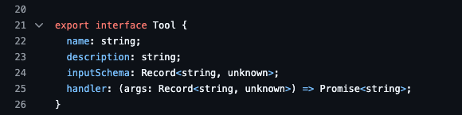
The code behind a tool call
GITHUB SOURCE · mcp-server/src/tools.ts
ONE TOOL CALL
index.ts
→
tools.ts
→
S3 vault
MCP routes
Contracts and handlers
Markdown files
auth.ts checks access
dcr.ts handles /register
day.ts supplies local dates
Notes:
This is a genuine GitHub capture of the public template's tools.ts Tool interface. The capture predates later source additions, so its visible line numbers are not a current reference. The interface still has the same fields: name, description, inputSchema, and handler. In the main tool path, index.ts accepts HTTP/MCP requests, checks access through auth.ts, and invokes a tool handler from tools.ts, which reads or writes Markdown in S3. dcr.ts serves the separate /register route for OAuth client setup. day.ts supplies local calendar dates to tools.ts. Sources: https://github.com/Arlovzki/vault-brain/blob/main/mcp-server/src/tools.ts and https://github.com/Arlovzki/vault-brain/blob/main/mcp-server/src/index.ts . Guide: https://www.arloubeloria.com/workshop/vault-brain#codebase-walkthrough and https://www.arloubeloria.com/workshop/vault-brain#tool-selection-code

Slide 17
ACTIVITY
Configure your stack and state
Create local config, verify your AWS account, then bootstrap remote state.
01
Create config
npm run configure
02
Set personal values
Edit terraform/terraform.tfvars
03
Validate setup
npm run preflight -- --client CLIENT
04
Bootstrap state
npm run bootstrap-state
Checkpoint: The main Terraform stack is connected to its remote S3 backend.
GUIDE www.arloubeloria.com/workshop/vault-brain#configure-stack
Notes:
npm run configure creates terraform/terraform.tfvars if it is missing. Edit profile, owner_email, project_name, region, and vault_tz. Replace CLIENT with claude-web or chatgpt. Rerun preflight to verify the personal AWS account before bootstrapping state. The Terraform state bucket is separate from the Markdown vault bucket. Guide: https://www.arloubeloria.com/workshop/vault-brain#configure-stack and https://www.arloubeloria.com/workshop/vault-brain#bootstrap-state

Slide 18
ACTIVITY
Deploy and verify
Build the Lambda and deploy S3, API Gateway, Cognito, IAM, and CloudWatch.
01
Deploy your stack
npm run deploy
02
Set Cognito password
Follow the hidden terminal prompt
03
Run the smoke test
npm run smoke
Checkpoint: The MCP endpoint reports all 12 tools and the smoke test passes.
GUIDE www.arloubeloria.com/workshop/vault-brain#run-deployment
Notes:
npm run deploy builds the Lambda, reviews Terraform plan, applies the stack, seeds starter Markdown only if the vault is empty, and prompts for a permanent owner password without echoing it. npm run smoke checks the 12-tool contract, unauthorized 401, and temporary write/read/delete. See https://www.arloubeloria.com/workshop/vault-brain#run-deployment and https://www.arloubeloria.com/workshop/vault-brain#set-password-and-test

Slide 19
How sign-in protects the vault
Your AI client signs in before it can use a vault tool.
01
You sign in
Cognito checks your owner account
02
Client gets access
Cognito issues an access token
03
A tool is requested
Lambda verifies the token first
PKCE protects the sign-in code exchange. Your client handles it.
GUIDE www.arloubeloria.com/workshop/vault-brain#pkce-s256
Notes:
When an attendee connects Claude web or ChatGPT, the client opens Cognito's authorization page. After the owner signs in, the client exchanges a one-time authorization code for an access token. PKCE protects that code exchange: the client sends an S256 challenge when sign-in begins and proves it has the original verifier at the token endpoint. This happens inside the client. S256 names the SHA-256 challenge method, not a public key. The MCP Lambda verifies bearer access before executing tools/call. Official Cognito reference: https://docs.aws.amazon.com/cognito/latest/developerguide/using-pkce-in-authorization-code.html . Guide: https://www.arloubeloria.com/workshop/vault-brain#pkce-s256

Slide 20
ACTIVITY
Connect one web AI client
Choose Claude web or ChatGPT. Both connect through the same authenticated /mcp URL.
01
Choose one path
Claude web or ChatGPT
02
Add the connector
Paste the deployed HTTPS URL ending in /mcp
03
Complete sign-in
Use Cognito, then confirm the tools appear
Checkpoint: Your chosen client can see and use the Vault Brain tools.
GUIDE www.arloubeloria.com/workshop/vault-brain#choose-client
Notes:
These are alternative primary live paths. Each attendee needs one, not both. The guide has selected real UI captures for both paths. Claude Code and Codex capture hooks are bonus material. See https://www.arloubeloria.com/workshop/vault-brain#connect-claude-web and https://www.arloubeloria.com/workshop/vault-brain#connect-chatgpt

Slide 21
ACTIVITY
The four-prompt test
Use the full prompts in the guide to capture, find, and read one test note.
01
Ask
What is waiting in my vault inbox?
02
Capture
Save a note containing blue mango 42
03
Find
Find the exact phrase blue mango 42
04
Read
Read the complete note back to me
Checkpoint: Your client reports a saved path, finds the phrase, and reads the note.
GUIDE www.arloubeloria.com/workshop/vault-brain#core-prompt-loop
Notes:
The guide supplies the four verbatim prompts. The marker blue mango 42 is only for the test. Guide: https://www.arloubeloria.com/workshop/vault-brain#core-prompt-loop

Slide 22
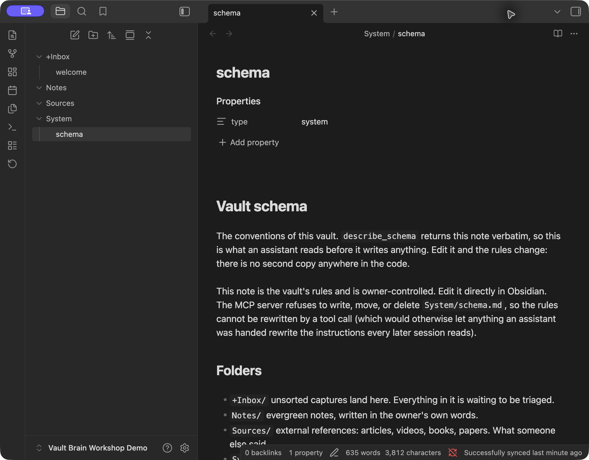
ACTIVITY
Obsidian closes the loop
Sync the same Markdown in both directions.
01
Create an empty vault
02
Enable Community plugins
03
Set up Remotely Save for S3
REAL SYNCED VAULT
Checkpoint: the AI finds your Obsidian note, and Obsidian shows the AI-created note.
GUIDE www.arloubeloria.com/workshop/vault-brain#obsidian-guide
Notes:
Required live activity: create an empty Obsidian vault, exit Restricted mode after reviewing the warning, install Remotely Save, enter bucket-scoped S3 credentials, check connectivity, sync manually, then prove both directions using blue-orbit-47 from Obsidian and silver-comet-82 from the AI client. Remotely Save syncs directly with S3 and does not use MCP or Cognito. Guide: https://www.arloubeloria.com/workshop/vault-brain#obsidian-guide and https://www.arloubeloria.com/workshop/vault-brain#obsidian-roundtrip . Source: https://github.com/remotely-save/remotely-save .

Slide 23
Keep going
Your memory has an address you control.
www.arloubeloria.com/workshop/vault-brain
BONUS AFTER THE WORKSHOP
Capture Claude Code or Codex session summaries in the vault.
Questions?
Notes:
The live workshop ends after the two-way Obsidian proof. The Claude Code and Codex coding-session capture hooks are a bonus path at https://www.arloubeloria.com/workshop/vault-brain#session-hook . Keep the S3 sync key and plugin data.json private. The guide destination depends on deployment to www.arloubeloria.com.

